Slide 1


Shield Insurance Performance Analysis

Slide 2
About Shield Insurance
Shield Insurance offers customized insurance options for both individuals and businesses, ensuring the protection of their assets and overall welfare. We are dedicated to providing thorough coverage and dependable service to our clients. Our goal is to be the reliable shield that our clients can depend on for security and peace of mind during challenging times.

Slide 3
Project Over-View
Shield Insurance has established sales offices in major cities such as Delhi NCR, Indore, Chennai, Mumbai, and Hyderabad. We provide a wide range of 9 policies that cater to various needs. These policies can be accessed through our user-friendly website and app, as well as through offline channels with the assistance of our agents and direct services. Our goal is to meet consumers' demands efficiently and effectively.
With our extensive selection of policies, customers have plenty of options to choose from, ensuring that their specific needs are met. Moreover, our online platforms enable clients to research and purchase policies conveniently from the comfort of their own homes, offering a modern and hassle-free experience.

Slide 4
Initial Observations
Total Revenue: 989.25 million INR
Total Customer Base: 26,841,
Customer Age Range: 18-65+
The company operates with two sales modes, each with two categories to cater to diverse customer needs.

Slide 5
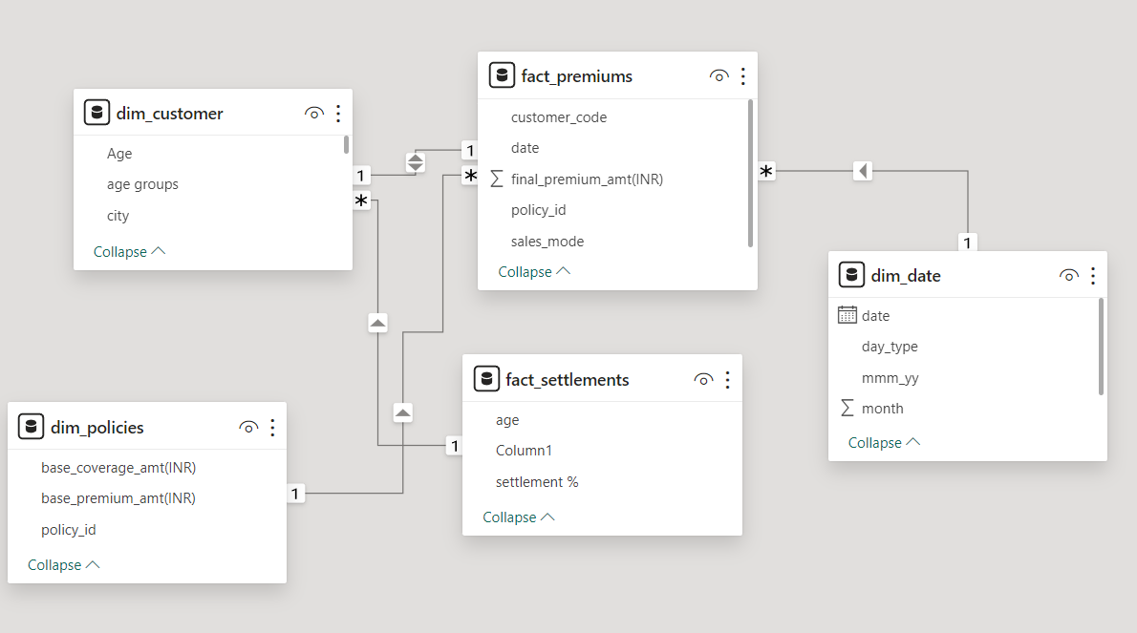
Data Modelling
Star Schema
Fact_tables: fact_premiums fact_settlements
Dimension_tables: dim_date dim_policies
dim_customer

Slide 6
Dashboard with Analysis

Slide 7
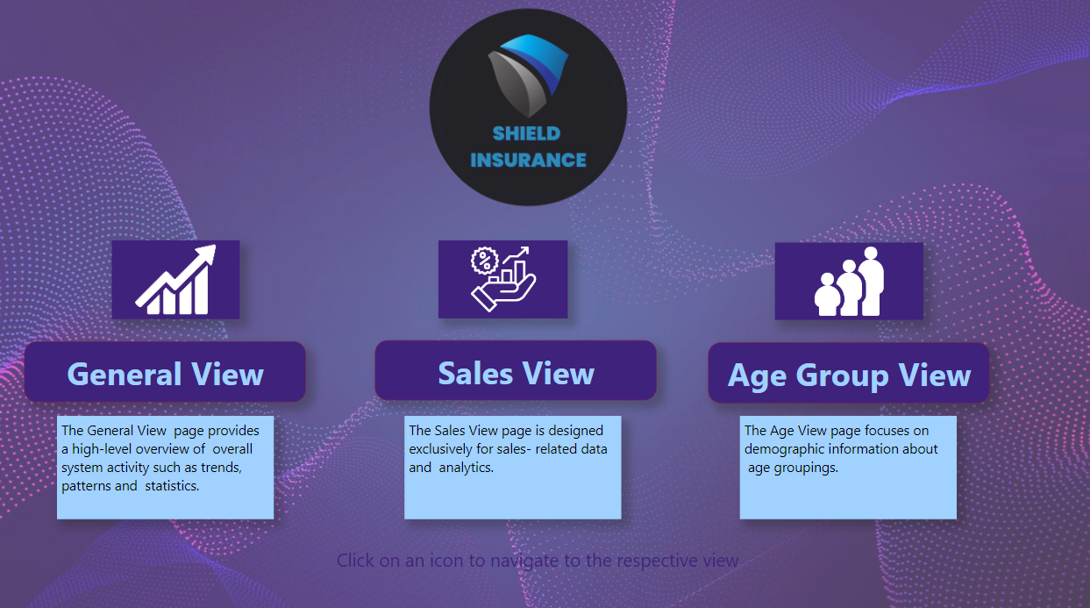
Home Page

Slide 8
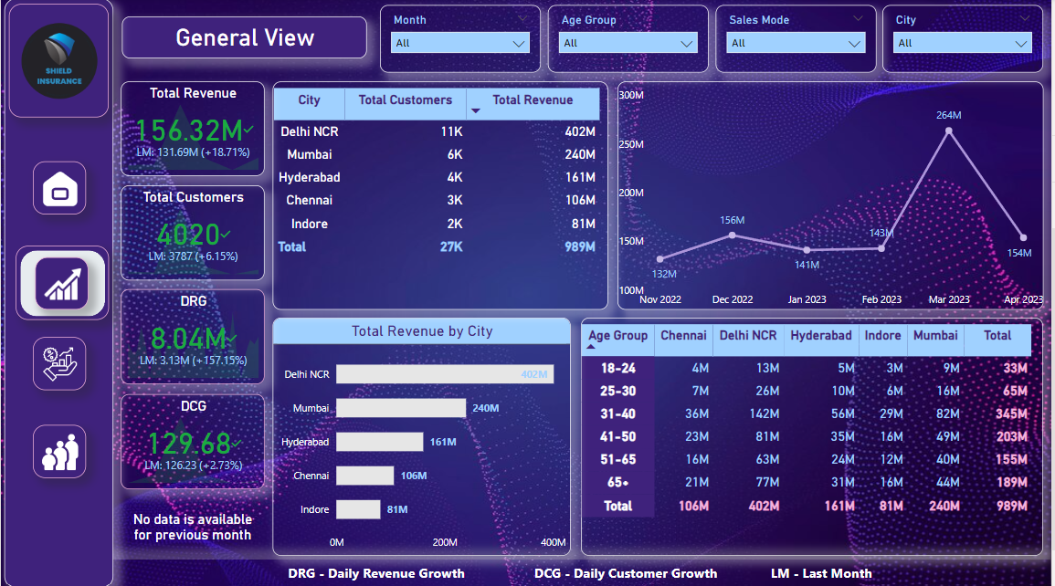
General View
1. Delhi NCR excelled in revenue and customer acquisition when compared to other cities, with a total of 11,007 customers and revenue totaling 401.6 million.
March is the peak month for revenue generation, reaching a total of 0.26 billion.
Additionally, March saw the highest number of customer acquisitions, with an impressive 7,100 new customers.
The age group of 31-40 years showed the highest revenue generation and the largest customer base.

Slide 9
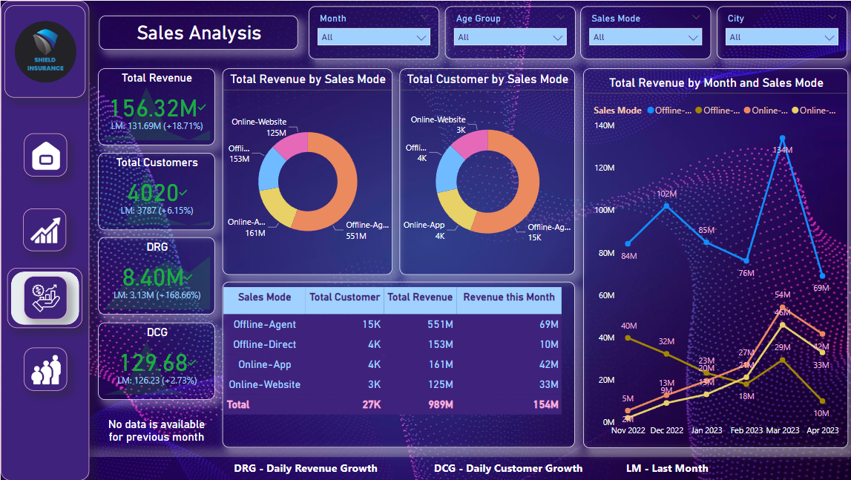
Sales Analysis
The Offline-Agent mode is the most successful approach for generating revenue and acquiring customers. Since February 2023, online app and website revenue has been growing, but revenue from direct offline sales has declined. The dominant channel for acquiring clients is still the offline agent, which contributes to 55.4% and 55.7% of the revenue, respectively.

Slide 10
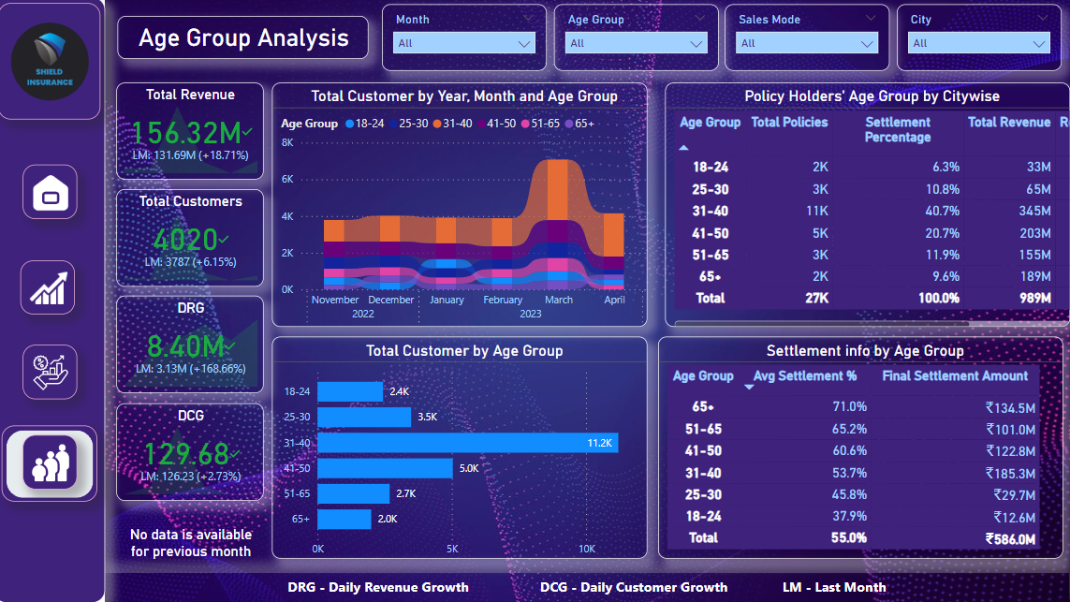
Age Group Analysis
In March 2023, there was a significant surge in customer acquisition within the 31-40 age range.
Out of all the policy plans, the 31-40 age group proved to be the most reliable customer base.
Individuals aged 65 and older can expect a settlement percentage of around 71%, while those aged 18 to 24 can expect it to be around 37%.

Slide 11
Summary of Analysis
Targeting the 18-24 Age Group: By directing efforts towards this age group, there is a chance to develop products and implement customized marketing strategies, despite having fewer customers and revenue compared to other demographics.
Capitalizing on the Senior Market: The company's strength in serving seniors is evident through the substantial customer base and revenue generated by the 65+ age group. This indicates potential for further growth by offering tailored products and services.
Exploring Strategic Partnerships: Expand the company's reach and provide exclusive discounts to customers across different age groups by forming partnerships with healthcare providers, financial institutions, or other relevant businesses.
Enhancing Online Presence: The online domain offers opportunities for growth, even though online sales modes currently contribute a smaller share of customer acquisition and revenue.
Agent Training and Support: Strengthen the performance of the offline-agent sales mode by investing in continuous training and support for agents. This will enhance their skills, product knowledge, and customer service capabilities.

